Slide 1
Overall idea
IRC: use the markovian property to solve the POMDP in the reverse order for likelihood. Then maximize the likelihood wrt theta.
Need to solve n times for 1 trajectory data, n as samples, pretty slow.
Need a decent data size. Very hard to search for a theta given few trajectories, since the inverse model did not learn to generalize.
Thus, we need to have a large data set before inverse. Cannot do active learning.

Slide 2
Overall idea
Active IRC.
Use a network to learn the solution of reverse POMDPs and generalize over different samples.
Instant inverse, inverse is just network inference. Able to use very few data to update theta iteratively, by variational inference for example.
Allow active learning. Active learning requires 1. have a theta prior (near online inverse) and 2. calculation of information. This approach potentially allows active learning. The inverse model can have targeted exploration of subject’s internal model, instead of random exploration.

Slide 3
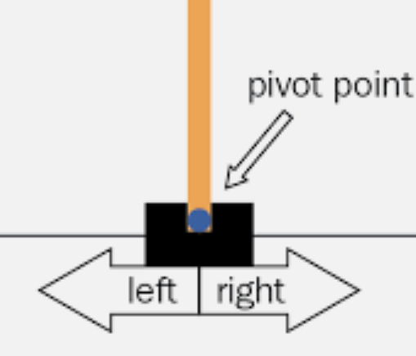
Cartpole as an example task
4 observation
3 action (left, right, no action)
Phi: pole length
Theta: pole length

Slide 4
Work flow
Task configuration, phi
Agent assumption, theta
Trajectories, T_sim
1, collect all trajectories T_sim by MDP, T(phi, theta)
2, train a backward function F, such that F(T_phi,theta) -> phi, theta
3, use the backward function F to inference as inverse, F(T_actual)->theta
4, use the T_sim, F, and current theta_hat to actively choose best phi

Slide 5
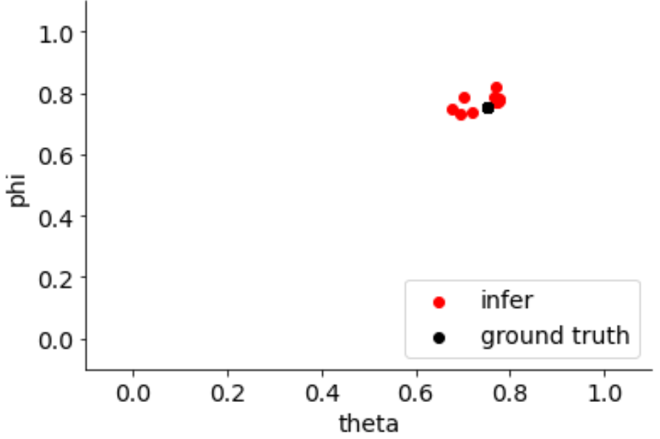
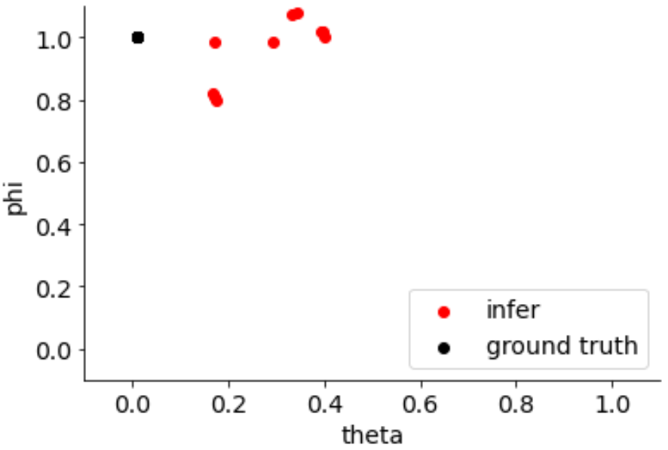
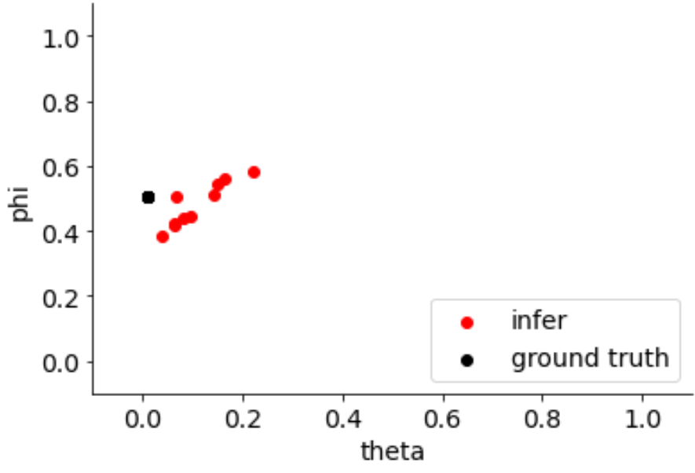
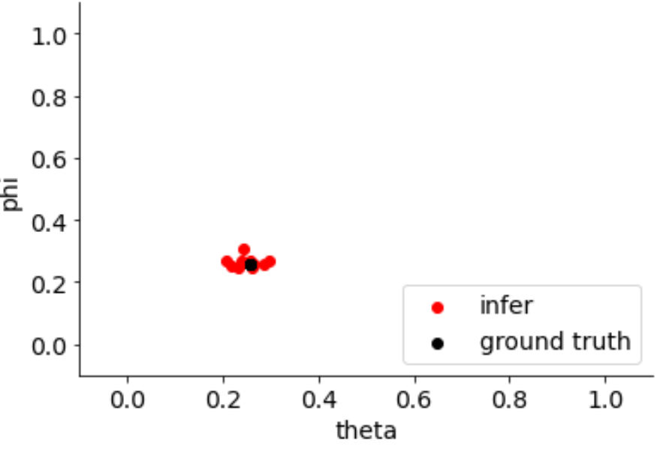
example
Resolution=5,
1000 trial per condition
25 conditions
Mseloss,
Output deterministic

Slide 6
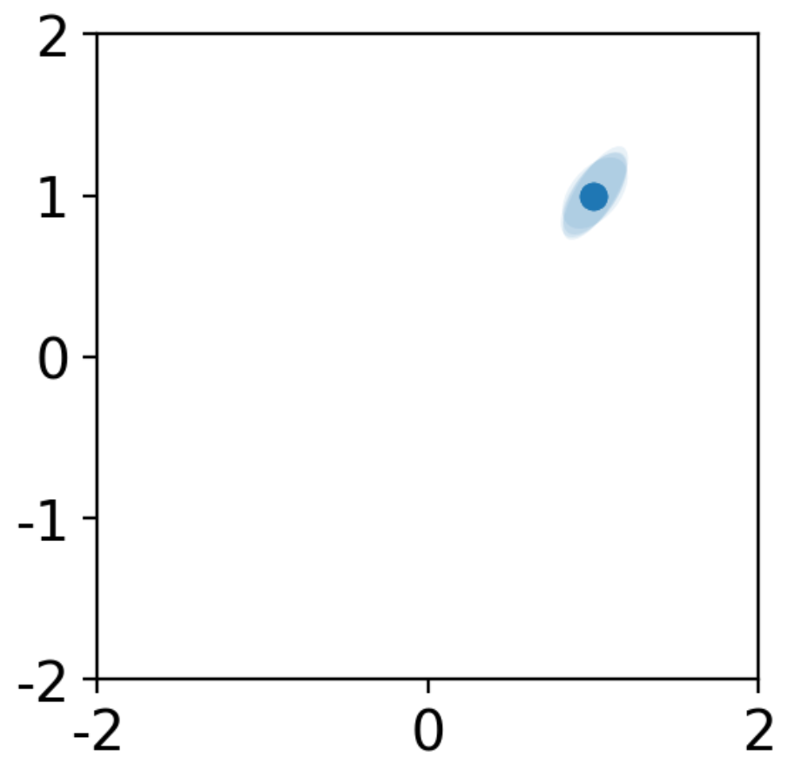
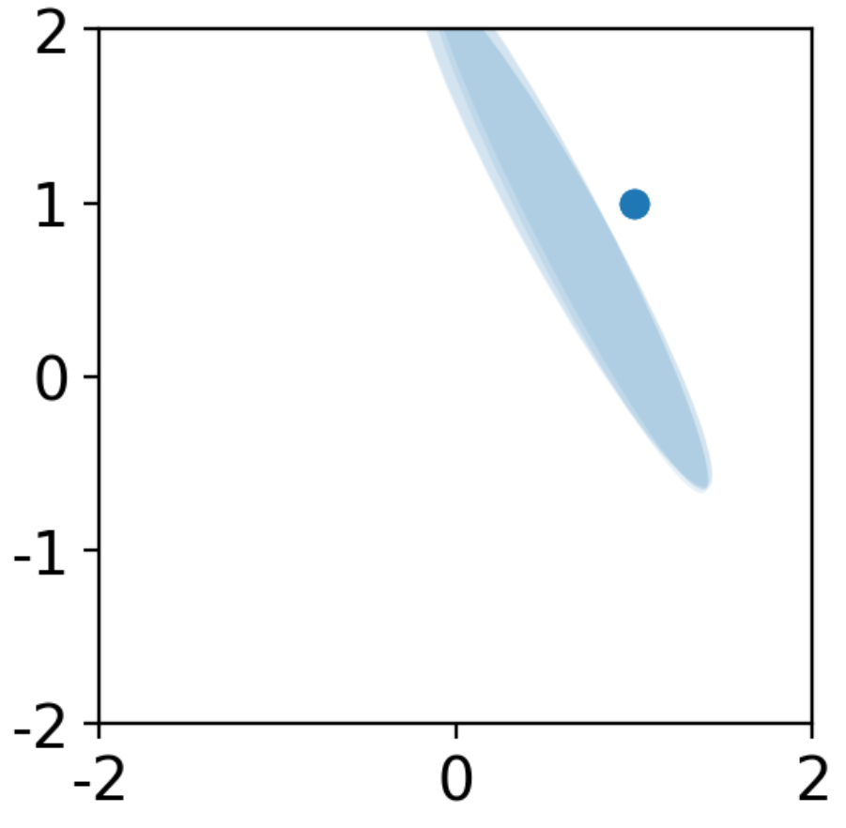
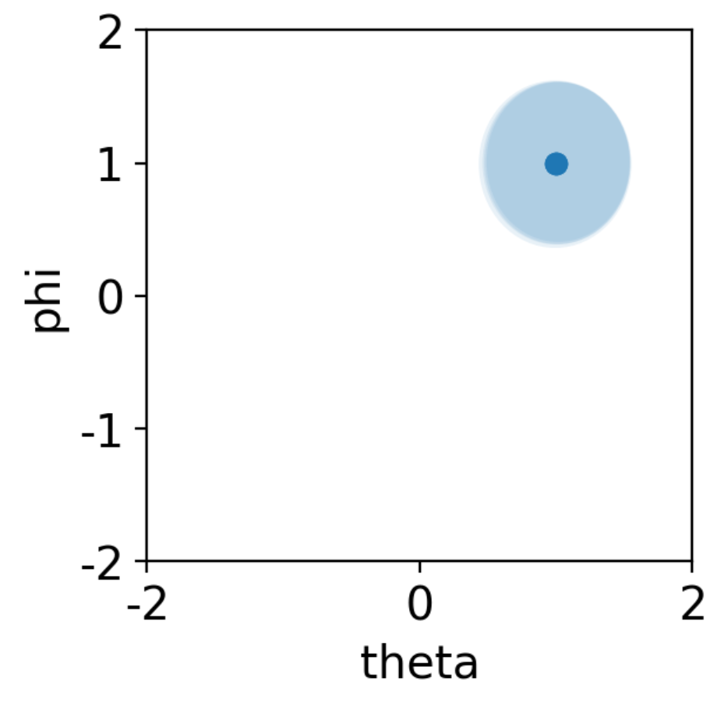
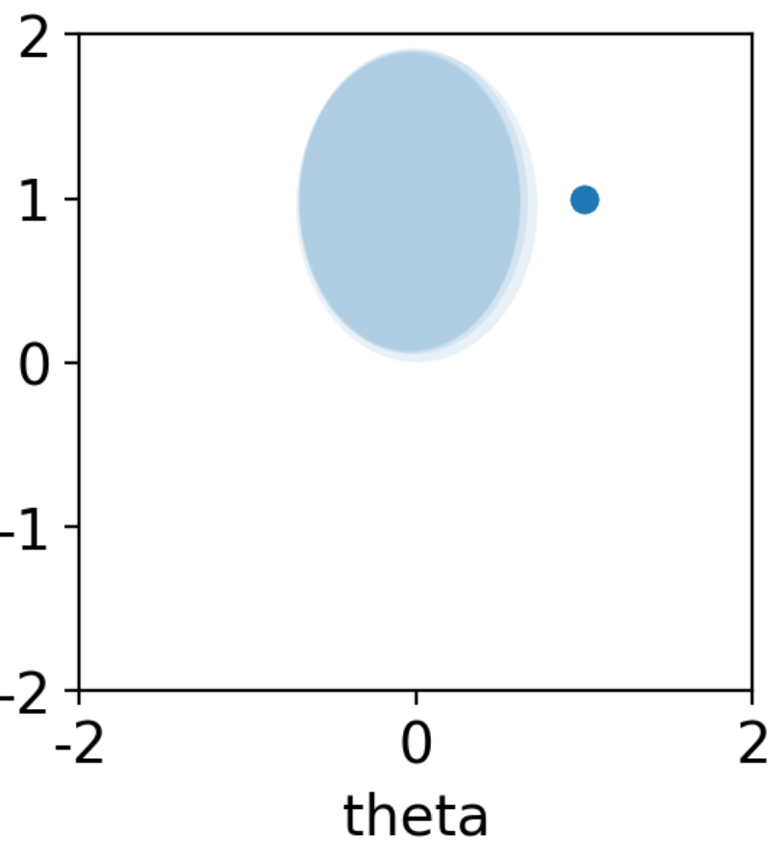
example
Use covariance
if early stop or use the best model
Same data
Output probability
-log likelihood and mse
Very unstable!
Not stable!
Use variance only
if only use variance not covariance, still not stablef.

Slide 7


Active learning
Starts from a theta prior. P(theta)
We want to know, what task (phi) provide maximum information about theta.
Eg, we want a task phi_i, such that the trajectory of T(phi_i, peak theta) differs from T(phi_i, other theta).
This can be formulated as:
For each phi_i,
{use the (phi_i) as key to get a row of trajectory T_phi.
weight the trajectory change with p(theta): abs(diff(T_phi) dot p(theta)}
take the argmax phi as the most informative task.
The abs(diff(T_phi) can be pre calculated. The complexity is n dot operations, where n is the number of tasks to choose from.

Slide 8
Active learning example
F output probability.
subF output vector trajectory embedding.
Start from a theta prior
for all phi, calculate sum(p(theta) . subF(phi)).
find the max phi, this is our best task.

Slide 9
Next step
For active learning, we need a slightly hard task?
now, we can do near one shot learning
also, no task config is significantly better than others.
decrease trial len?
For probability output.

Slide 10










Slide 11



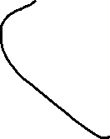




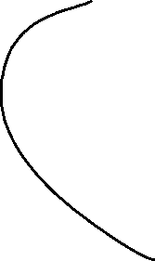



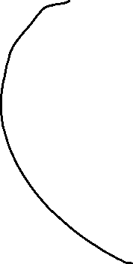

Slide 12


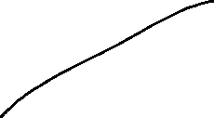


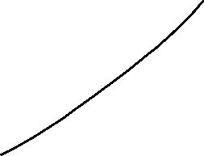







Slide 13




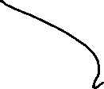

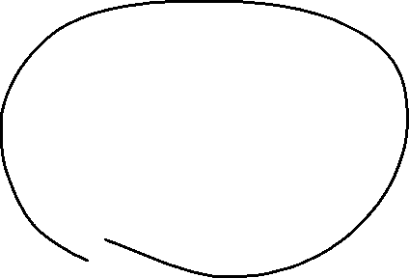







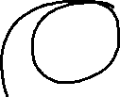
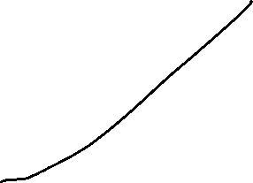




Slide 14
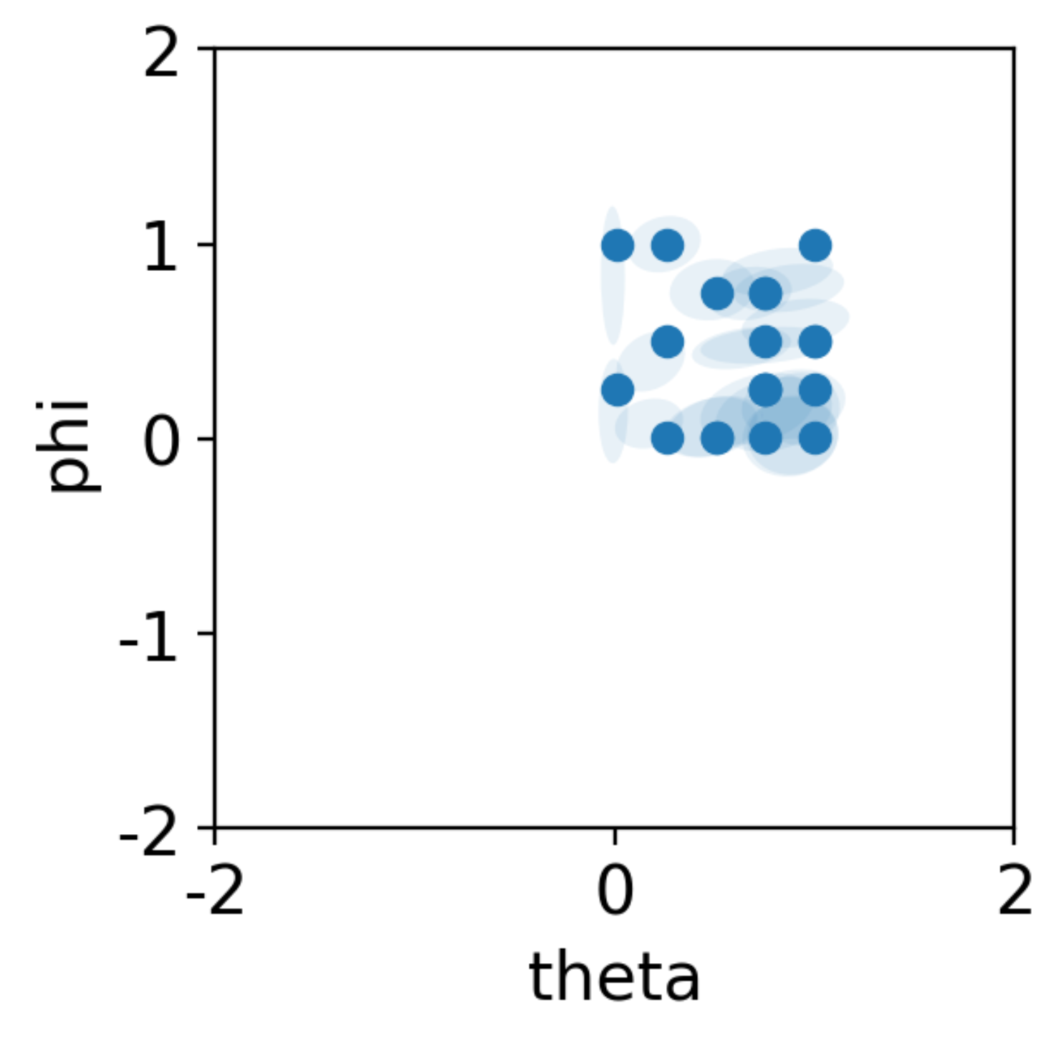
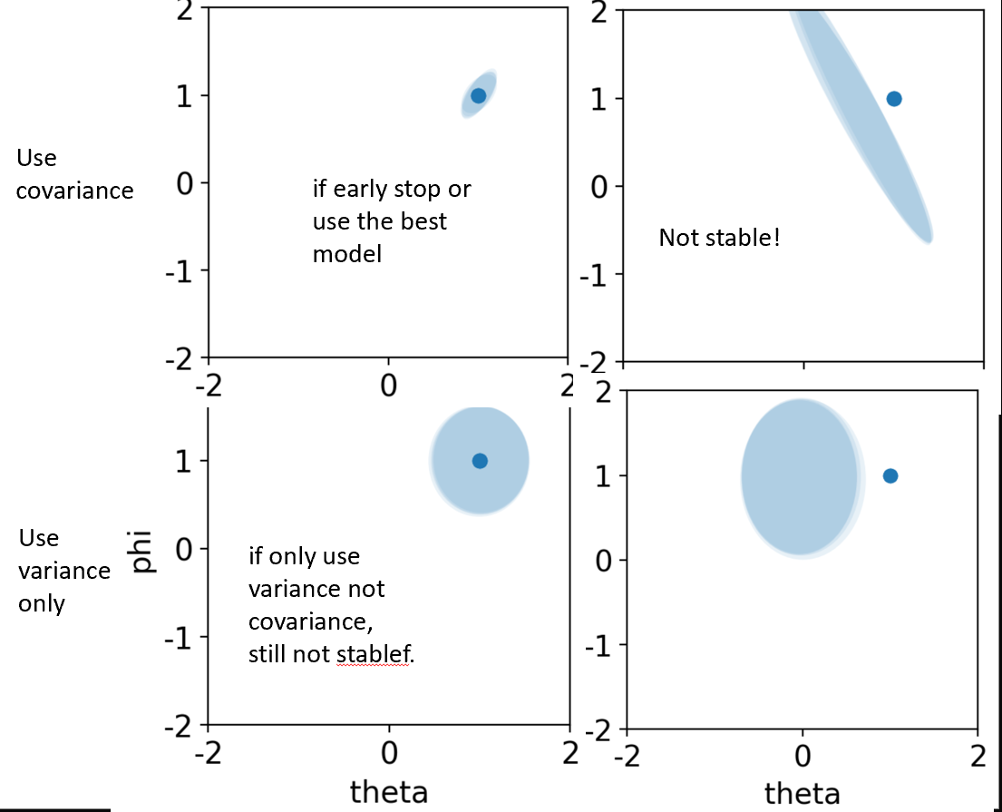
Mean+cov ouput, continuous case
Figured out a grad clipping that make the network stable
Left: previous, right, updated

